Slide 1
Week4
DeiT, ConVIRT & Clip

Slide 2
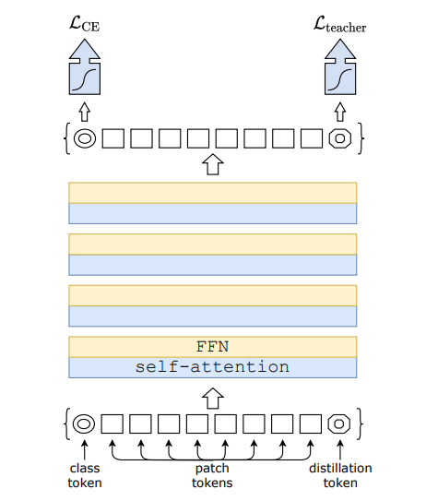
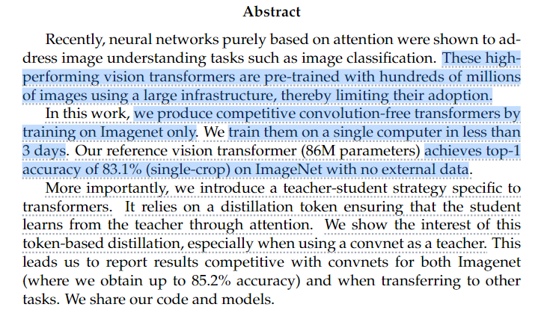
DeiT
Model Architecture
Distillation
Performance

Slide 3
Model Architecture
Ground truth
student
ViT
Class token
Distillation token
RegNet
Label
input
teacher
ViT

Slide 4
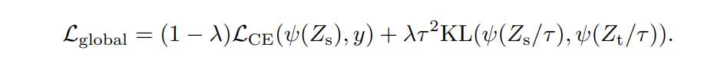


Distillation
Softmax
Ground truth
Soft Distillation
Hard-label Distillation

Slide 5
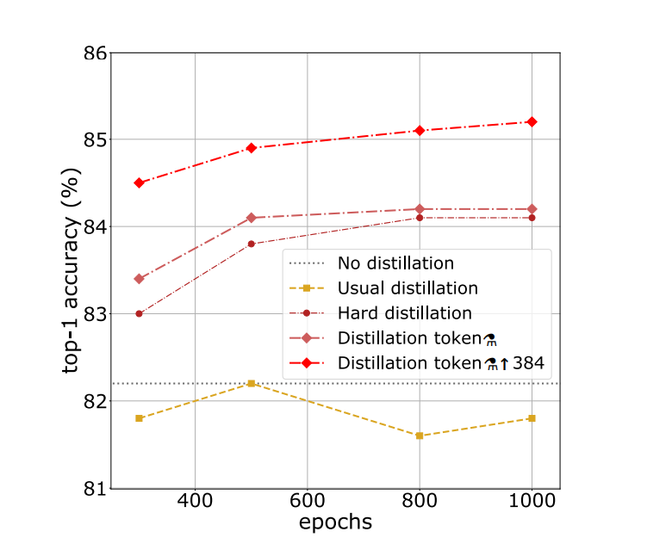
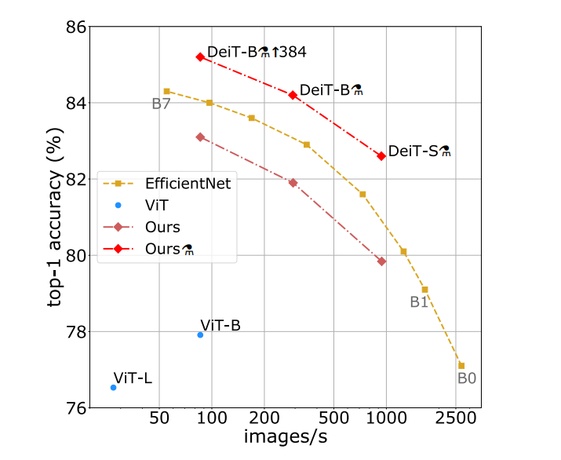
Performance
Throughput, bigger throughput size means smaller para size

Slide 6
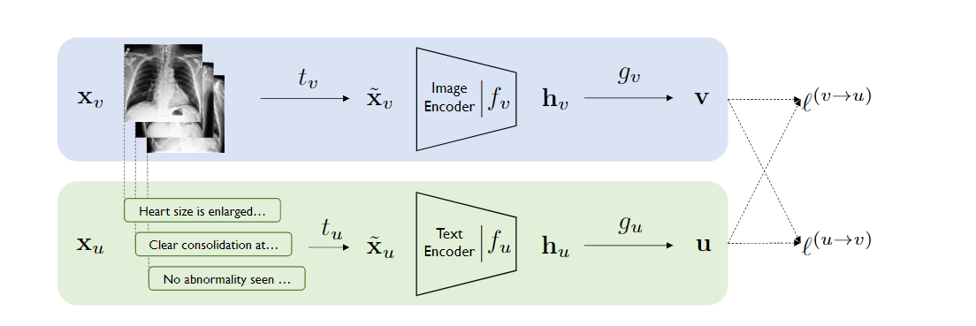
ConVIRT
Model Architecture
Loss Function

Slide 7
Model Architecture
$g_{v}\&$ $g_{u}$(Non-Linear Projection): linear(ReLU(linear()))
Random Data Augment
ResNet50
Bert : initialize with ClinicalBERT weight

Slide 8
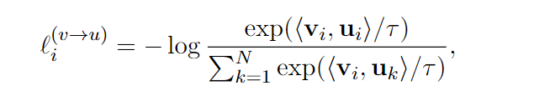
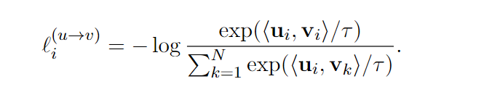
Loss Function
infoNCE Loss Function
Temperature para
Image to Text:
Cosine similarity
Text to Image:

Slide 9
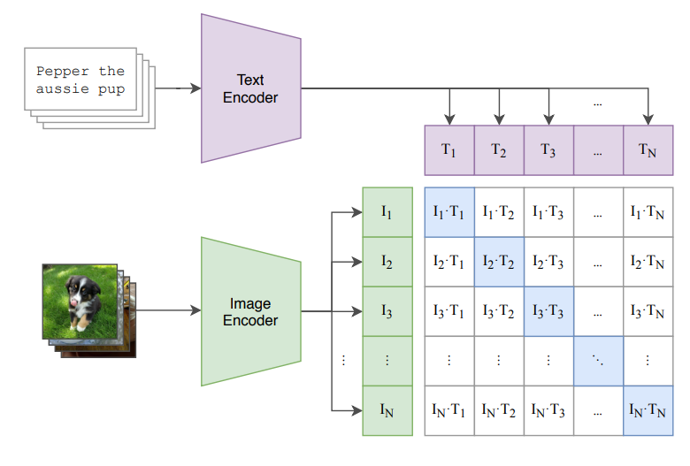
Clip
Model Architecture
Zero-Shot Prediction
Prompt Engineering

Slide 10
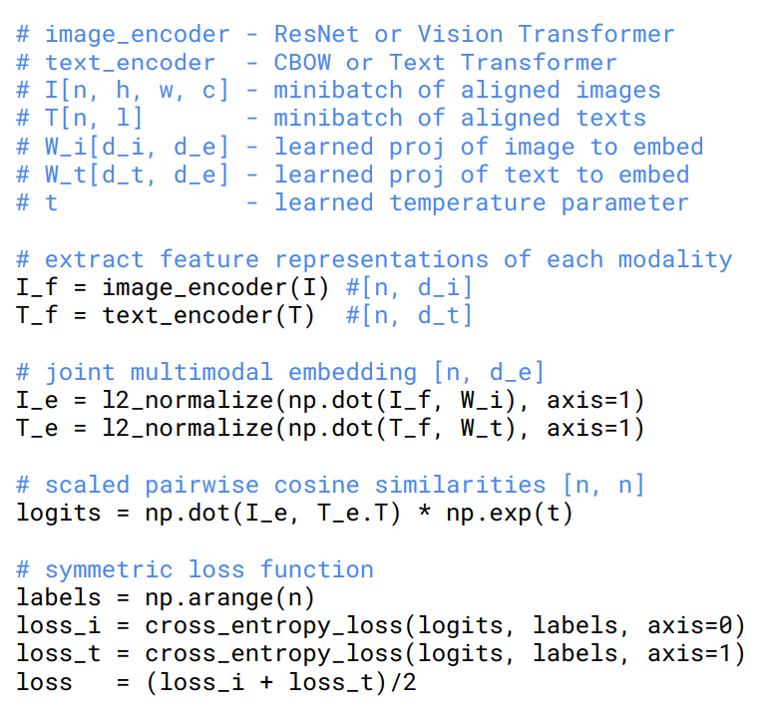
Model Architecture

Slide 11
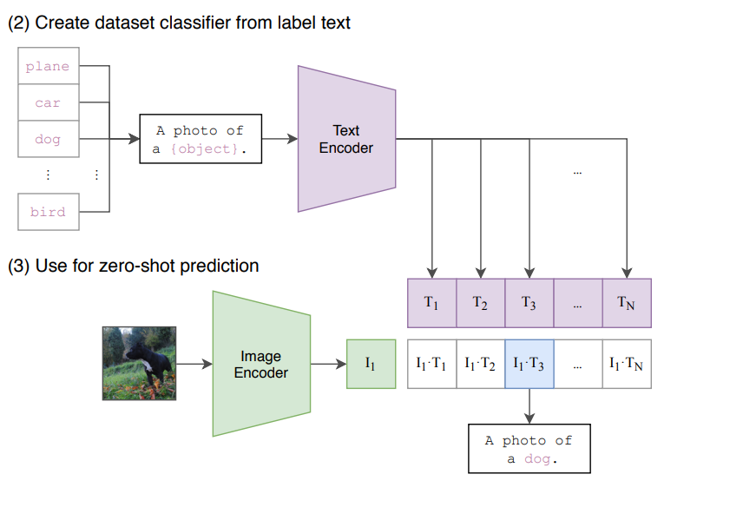
Zero-Shot Prediction
label
Compute Cosine similarity

Slide 12
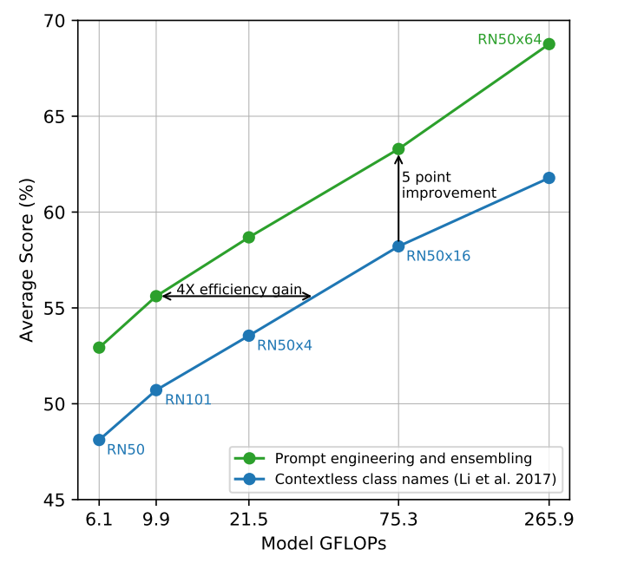
Prompt Engineering
Prompt
Notes:
ConVIRT中的image encoder的参数是ImageNet初始化的，而CLIP直接用random初始化；
ConVIRT的projection head是non-linear的，而CLIP采用linear的projection；
CLIP去掉了ConVIRT中text transformation（指均匀从text中采样句子），因为CLIP数据集中有很多只出现过一次的（image，text）；
CLIP的image transformation只用了resize和squared crop；
CLIP loss中的temperature参数τ是可学的。

